Slide 1

Front
Jessica
Brenda
Nicole
Heidi
Steven
Jessie
Linus
Waitlisted/
Auditors
We’re going clockwise!

Slide 2
The Structure of Websites
Week 1

Slide 3
Announcements
Lectures are mandatory, we apologize for any confusion in last week’s syllabus slides!
Please remember to
create your account on WDD Portal (wdd.io),
join our class on Piazza (link can be found in WDD portal),
and enroll in DES INV 198 on CalCentral
Homework will be announced on Piazza, due next Monday, 7:00 PM
Post your question on wdd.io/queue if you're shy to ask
Please download ONE of the text editors in the next slide (We recommend Visual Studio Code, Atom or Sublime!)

Slide 4
Creative tools
Web Browser
Chrome
Safari
Firefox
Opera
Edge
Code Editor
Visual Studio Code
Atom
WebStorm
Brackets
Sublime
Prototyping
Figma
Adobe XD
Keynote
Powerpoint
Illustrator

Slide 5
Quick Intro to Websites
<HTML>

Slide 6
Quick Intro to Websites
<HTML>

Slide 7
What is a website?
A website is traditionally a set of web pages served on a single domain
A web page is a document, usually written in HTML
A domain is an address (wdd.io) that represents a server where the files are located

Slide 8
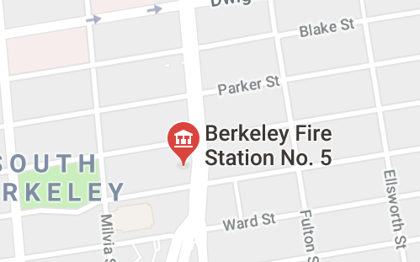
"Fire station"
2680 Shattuck Ave, Berkeley, CA 94704
Look up the address

Slide 9
207.38.86.245
Look up the address

Slide 10
<!DOCTYPE html PUBLIC "-//W3C//DTD XHTML 1.0 Transitional//EN""http://www.w3.org/TR/xhtml1/DTD/xhtml1-transitional.dtd">
<html xmlns="http://www.w3.org/1999/xhtml" xml:lang="en" lang="en">
<head>
<title>Web Design DeCal</title>
<meta name="description" content="A 2 unit course in UC Berkeley for anyone who wants to create a beautiful website." />
<meta property="og:title" content="Web Design DeCal" />
<meta property="og:url" content="http://www.wdd.io/" />
<meta property="og:image" content="http://www.wdd.io/static/thumbnails/logo.png" />
<meta property="og:description" content="A 2 unit course in UC Berkeley for anyone who wants to create a beautiful website." />
<meta property="og:site_name" content="Web Design DeCal" />
<meta name="twitter:title" content="Web Design DeCal">
<meta name="twitter:description" content="A 2 unit course in UC Berkeley for anyone who wants to create a beautiful website.">
<meta name="twitter:image" content="http://www.wdd.io/static/thumbnails/logo.png">
<link href='http://fonts.googleapis.com/css?family=Lato:300,400,700' rel='stylesheet' type='text/css'>
<link rel="stylesheet" type="text/css" href="/static/css/promotional.css" />
<link rel="shortcut icon" href="/static/icons/favicon.ico" />
<script type="text/javascript" src="/static/js/vendor/jquery-1.8.3.min.js" charset="utf-8"></script>
<script type="text/javascript" src="/static/js/vendor/jquery-ui-1.9.2.min.js" charset="utf-8"></script>
Fetch the file

Slide 11
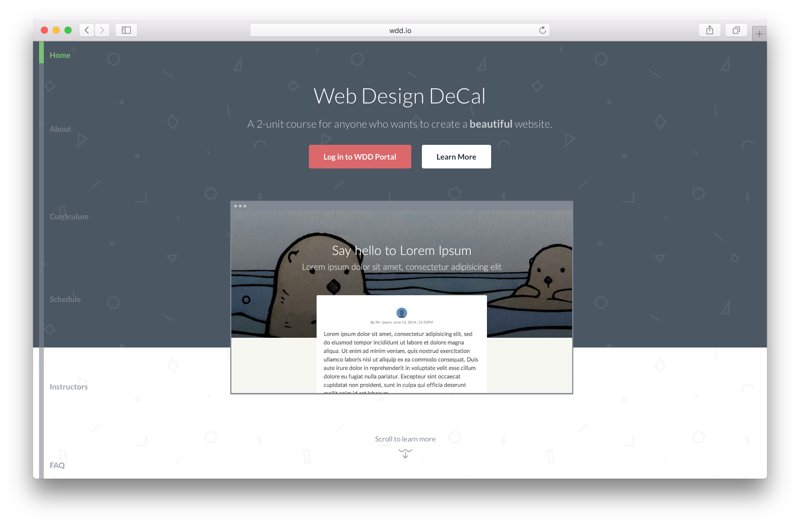
Render code on canvas

Slide 12
Two ends of a website (roughly speaking)
Front end
What users can see &
what happens in your web browser
e.g. text, images, buttons
Back end
What users can't see &
beyond your web browser
e.g. business logic, data storage

Slide 13
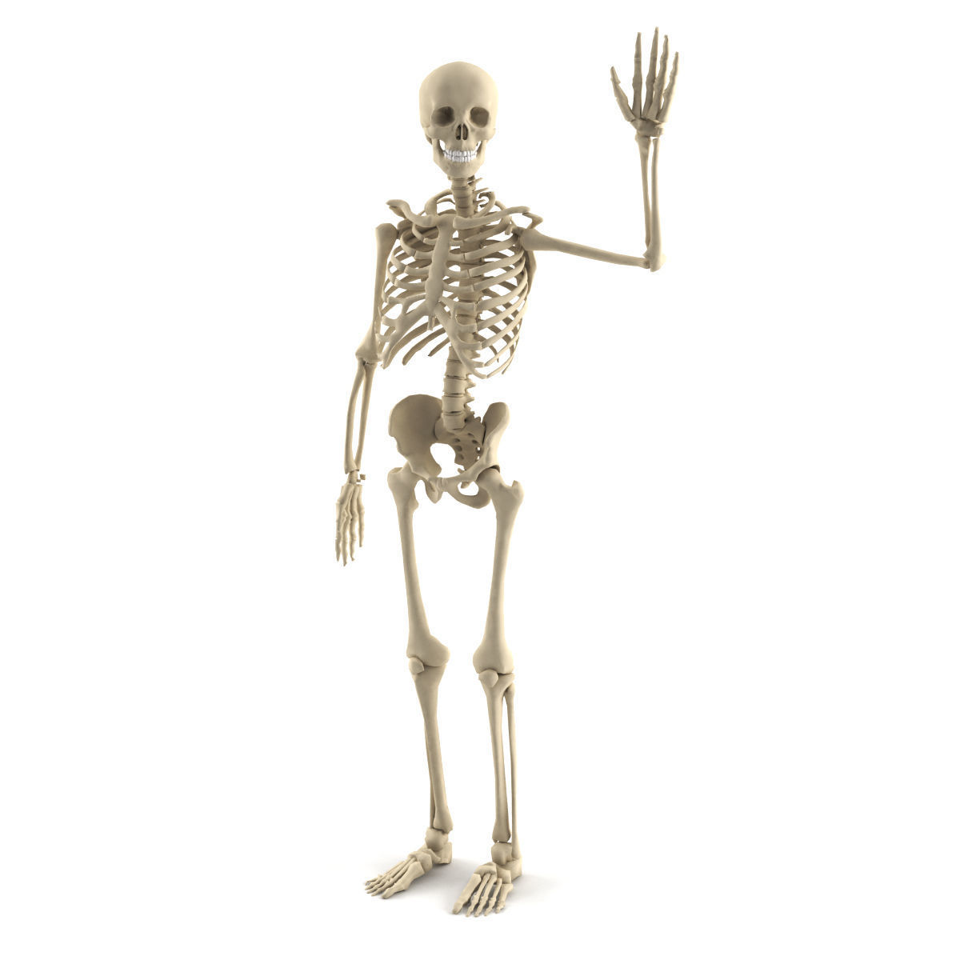


What websites are made of
HTML
Structure
CSS
Design
JavaScript
Function

Slide 14
HTML provides the structure of the page
A well-written HTML document should be "understandable" without a stylesheet

Slide 15
<!DOCTYPE html PUBLIC "-//W3C//DTD XHTML 1.0 Transitional//EN""http://www.w3.org/TR/xhtml1/DTD/xhtml1-transitional.dtd">
<html xmlns="http://www.w3.org/1999/xhtml" xml:lang="en" lang="en">
<head>
<title>Web Design DeCal</title>
<meta name="description" content="A 2 unit course in UC Berkeley for anyone who wants to create a beautiful website." />
<meta property="og:title" content="Web Design DeCal" />
<meta property="og:url" content="http://www.wdd.io/" />
<meta property="og:image" content="http://www.wdd.io/static/thumbnails/logo.png" />
<meta property="og:description" content="A 2 unit course in UC Berkeley for anyone who wants to create a beautiful website." />
<meta property="og:site_name" content="Web Design DeCal" />
<meta name="twitter:title" content="Web Design DeCal">
<meta name="twitter:description" content="A 2 unit course in UC Berkeley for anyone who wants to create a beautiful website.">
<meta name="twitter:image" content="http://www.wdd.io/static/thumbnails/logo.png">
<link href='http://fonts.googleapis.com/css?family=Lato:300,400,700' rel='stylesheet' type='text/css'>
<link rel="stylesheet" type="text/css" href="/static/css/promotional.css" />
<link rel="shortcut icon" href="/static/icons/favicon.ico" />
<script type="text/javascript" src="/static/js/vendor/jquery-1.8.3.min.js" charset="utf-8"></script>
<script type="text/javascript" src="/static/js/vendor/jquery-ui-1.9.2.min.js" charset="utf-8"></script>
HTML example from wdd.io

Slide 16
CSS provides the design of the page
Just several lines of "code" is enough to create "design" shapes, color, buttons, you name it

Slide 17
body {
margin: 0;
font-family: 'Lato', sans-serif;
background: #f7f5f2;
-webkit-font-smoothing: antialiased;
}
a {
color: inherit;
text-decoration: none;
}
.img-scaled {
width: 100%;
}
.img-scaled-wh {
width: 100%;
height: 100%;
object-fit: cover;
}
.clear {
clear: both;
CSS example from wdd.io

Slide 18
JavaScript provides the function of the page
What will happen to websites with JavaScript disabled?

Slide 19
function resize_dom(window_height) {
$('.schedule-item')
.css('padding-top', (($(window).height() - window_height) / 2) + 'px');
$('.schedule-item:nth-child(12)')
.css('padding-bottom', (($(window).height() - window_height) / 2) + 'px');
$('#apply-header').css('height', $(window).height() - 180 + 'px');
setTimeout(function(){
scheduleOffsetDict = {};
$('.schedule-item').each(function(i){
scheduleOffsetDict[$(this).position().top - 120] = i;
});
}, 100);
}
function set_cover() {
var offsetY = $(window).height() * 0.7 - 340;
$('.window-container').css('top', offsetY);
}
$(document).ready(function(){
set_cover();
JavaScript example from wdd.io

Slide 20
What websites are made of
HTML
Structure
CSS
Design
JavaScript
Function
Notes:
Last week, we went over what websites and webpages are -- websites are a place on the web that’s a collection of webpages, and webpages (and hence websites) are made from at least three basic components: HTML, CSS, and JavaScript.
HTML is code that provides the basic structure of a webpage. It tells you what content is on the page, from headings and body text (paragraphs) to buttons and input fields and images and video. You could say HTML is the skeleton of the page.
But just webpages made from just HTML won’t look great, because it contains only the very basic structure of the content. To add things like color, fonts, layout, animations, and different sizes of elements on the page, we turn to CSS, which adds design elements to the page.
Many times, we want webpages to be more than just a decorated, pretty list of words and images. We want webpages to be interactive, to respond to button clicks and our inputs and show us new information depending on how we interact with the content on the webpage. That’s where JavaScript comes in. JavaScript (JS) is a programming language we’ll use to add interactivity to our webpages, so it can have function as well as form.

Slide 22
Quick Intro to Websites
<HTML>

Slide 23
What is HTML?
What does it look like?
How do we use it?

Slide 24
What is HTML?
What does it look like?
How do we use it?

Slide 25
What is HTML?
Hypertext Markup Language
A collection of tags related to each other in parent-child relationships
Notes:
HTML is an initialism that stands for HyperText Markup Language. “HyperText” is a fancy word for text that contains links to other text and files -- webpages. “Markup” is another word for code that represents some formatted bit of text, and “language” is the “language” as in “programming language.”
HTML code is just a collection of tags related to each other in parent-child (“nested”) relationships.
What does that mean?

Slide 26


What is HTML?
Hypertext Markup Language
A collection of tags related to each other in parent-child relationships
Matryoshka Dolls
A collection of dolls related to each other in nested relationships
Notes:
(cont’d)
“Parent-child relationships” mean that some tags in HTML contain other tags within them, like Matryoshka nesting dolls. In fact, in HTML, one tag will often contain more than one tag inside it.
This “nested” structure exists because our webpage content tends to have nested structure. For example, a page may contain many sections -- a header, an article body, and a footer. A header could contain many buttons and links, and each button may contain both images and text. There’s a clear hierarchy in content, and the tags that represent things like headers, buttons, images, and text will contain each other to represent this relationship that exists on the webpage.

Slide 27
What is HTML?
What does it look like?
How do we use it?

Slide 28


Anatomy of an HTML Document
<!doctype html>
<html>
<head></head>
<body>
<!-- this itself is a comment -->
<!-- your webpage content
goes inside the body tag -->
<p>Welcome to WDD!</p>
<img src=”wdd.png” />
</body>
</html>
Welcome to WDD!
(size may vary on your screen, but that’s ok!)
Notes:
This is HTML code! It may look daunting, but if we break it down, it’s quite sensible.
Each of the bits that look like <this>, with angle brackets on either side, are tags. For example, the <html> tag (which is followed at the end by </html>) represents the entire HTML “document” or webpage file. You can see that the HTML document here is just a series of nested tags.
Also notice that often, a tag like <this> is followed later by a tag like </this>, with a slash through it. That indicates the beginning and end of the tagged section. In the case of <html>, the opening tag <html> starts the HTML section of the document, and the closing tag </html> ends the section.
Let’s start from the top and work our way down.

Slide 29
Tags are the building blocks of HTML
And they "usually" come in pairs
Notes:
If you’ve been following along, you’d have noticed that most of the tags we covered so far come in pairs -- opening tag, then the content inside, followed by a closing tag.
Closing tags look just like opening tags, except that they have a slash “/” following the opening angle bracket “<”.

Slide 30
Opening tag
<!doctype html>
<html>
<head></head>
<body>
<!-- this itself is a comment -->
<!-- your webpage content goes inside the body -->
<p>Welcome to WDD!</p>
<img src=”wdd.png” />
</body>
</html>

Slide 31
Closing tag
<!doctype html>
<html>
<head></head>
<body>
<!-- this itself is a comment -->
<!-- your webpage content goes inside the body -->
<p>Welcome to WDD!</p>
<img src=”wdd.png” />
</body>
</html>

Slide 32
Pair of paragraph tags
<!doctype html>
<html>
<head></head>
<body>
<!-- this itself is a comment -->
<!-- your webpage content goes inside the body -->
<p>Welcome to WDD!</p>
<img src=”wdd.png” />
</body>
</html>
Notes:
Within the body, after the comment tags, we have a pair of <p> tags! <p> are paragraph tags, but since <paragraph> is too long, HTML abbreviates it to <p>.
Notice that every <p> tag has a corresponding </p> closing tag, and the text that makes up the paragraph sits in between the opening and closing tags. (You may even say the text is nested inside the paragraph tag.)
By default, text you place inside <p> will be displayed in a small, regular font on the page stretching across the screen like words in a book.

Slide 33
One exception: self-closing tag
<!doctype html>
<html>
<head></head>
<body>
<!-- this itself is a comment -->
<!-- your webpage content goes inside the body -->
<p>Welcome to WDD!</p>
<img src=”wdd.png” />
</body>
</html>
Notes:
The exceptions to the “tags come in pairs” rule are called self-closing tags. These exist because some kinds of content can’t really contain other content. For example, it makes sense for a button to have an image inside it, but it doesn’t make sense for an image to have an input field inside, or for an input field to have a paragraph inside. These independent, self-contained elements are represented by self-closing tags, which have one tag that both opens and closes itself.
Self closing tags have just one tag, but it ends with a “/>” rather than a simple “>”.
One great example is the image tag, <img/>.

Slide 34
Tags can contain other tags, text, or a combination of 'em

Slide 35
Words inside paragraph tags
<!doctype html>
<html>
<head></head>
<body>
<!-- this itself is a comment -->
<!-- your webpage content goes inside the body -->
<p>Welcome to WDD!</p>
<img src=”wdd.png” />
</body>
</html>

Slide 36
Nesting tags
<!doctype html>
<html>
<head></head>
<body>
<!-- this itself is a comment -->
<!-- your webpage content goes inside the body -->
<p>Welcome to WDD!</p>
<img src=”wdd.png” />
</body>
</html>
Notes:
Mention that parent is body, child is p

Slide 37
Nesting more tags
<!doctype html>
<html>
<head></head>
<body>
<!-- this itself is a comment -->
<!-- your webpage content goes inside the body -->
<p>Welcome to WDD!</p>
<img src=”wdd.png” />
</body>
</html>
Notes:
Mention that parent is body, child is p

Slide 38
Tags begun with <! usually have special purposes <3

Slide 39
To begin an HTML5 document
<!doctype html>
<html>
<head></head>
<body>
<!-- this itself is a comment -->
<!-- your webpage content goes inside the body -->
<p>Welcome to WDD!</p>
<img src=”wdd.png” />
</body>
</html>
Notes:
Every HTML document should start with a line that looks like this: <!doctype html>
This tells the browser that what follows after this !doctype tag is an HTML document -- it’s telling us the document type. The ! before the doctype is important! Make sure not to leave it out.
This way to open an HTML document is actually specific to “HTML 5”, which is the fifth version (more or less… ) of the HTML code specification. In previous versions, the doctype tag took different forms. But if we use <!doctype html>, the browser will expect HTML version 5 code to follow, which is what we’ll cover in WDD.

Slide 40
Annotations/comments
<!doctype html>
<html>
<head></head>
<body>
<!-- this itself is a comment -->
<!-- your webpage content goes inside the body -->
<p>Welcome to WDD!</p>
<img src=”wdd.png” />
</body>
</html>
Notes:
Before we dive into the rest of the code, let’s touch on one important part of HTML -- comments.
Comments are text inside code that the computer just ignores. Comments are put next to code just to tell any human readers what’s going on, or help explain the code around it.
In HTML, comments begin with a <!-- and end with a →. Everything in between, the computer will ignore. You can use comments to add explanations or reasoning behind the code that sits around it.
Because the computer ignores all comments, any code that sits inside the comment block (<!-- -->) will be ignored by the computer as well. Make sure your code isn’t in a comment block if it doesn’t seem to be working.

Slide 41
Some special tags to structure an HTML page

Slide 42
Pair of html tags
<!doctype html>
<html>
<head></head>
<body>
<!-- this itself is a comment -->
<!-- your webpage content goes inside the body -->
<p>Welcome to WDD!</p>
<img src=”wdd.png” />
</body>
</html>
Don't forget about the <!doctype html> before <html>
Notes:
After the doctype tag, we see our first pair of opening and closing tags -- the <html> tag.
The <html> tag marks the beginning and end of the whole HTML document. You should put all of your HTML code within these <html> tags. If you don’t, nothing particularly terrible will happen, because web browsers tend to be good at fixing our human mistakes…. But you should still only put code between the <html> tags, because it’s good practice that good web developers follow.
We can see that </html> marks the end of the section that the <html> tag opened up top.

Slide 43
What is an html tag?
Contains everything of a webpage
There should only be one of this in the entire file
<html> </html>
Don't forget about the <!doctype html> before <html>
Notes:
A <head> tag is a tag that contains within it a bunch of different kinds of information that the webpage visitor won’t see on the page itself:
One important thing that we add in the <head> of a page is the page title. We don’t mean the title that appears on the top of the webpage itself. We mean the bit of text that appears at the top bar of your browser window or tab. In this presentation, the browser window shows the title “Week 1 - Programming”. We can specify a title for a webpage different from anything on the page itself, and we use the <title></title> tag within <head> to do so.
<head> also contains references to what CSS and JavaScript files belong on the page, and other metadata like authors, publication date, and languages (human languages) used on the page. These don’t show up on the page, but help browsers make better sense of the webpage content.

Slide 44
Pair of head tags
<!doctype html>
<html>
<head></head>
<body>
<!-- this itself is a comment -->
<!-- your webpage content goes inside the body -->
<p>Welcome to WDD!</p>
<img src=”wdd.png”/>
</body>
</html>
Notes:
Within the <html> tag, we have our <head> tag. The <head></head> is a section of the HTML document that isn’t visible on the page, but that gives the computer and browser important information about the page, as well see.
You may also notice that we’ve indented this whole section inside the <html> tag by a few spaces. This isn’t strictly required -- computers will understand code without indentation -- but indenting code to mirror the nested structure of our tags helps us humans read the code better, and lots of great programmers indent code for that reason. So we should too.

Slide 45
What is a head tag?
User does not see what is here
Sets up the page
Title (on tab) of page
Links to important resources
CSS and JS files
Fonts
Author(s) of webpage
Other metadata
Sits inside <html></html>
<head> </head>
Notes:
A <head> tag is a tag that contains within it a bunch of different kinds of information that the webpage visitor won’t see on the page itself:
One important thing that we add in the <head> of a page is the page title. We don’t mean the title that appears on the top of the webpage itself. We mean the bit of text that appears at the top bar of your browser window or tab. In this presentation, the browser window shows the title “Week 1 - Programming”. We can specify a title for a webpage different from anything on the page itself, and we use the <title></title> tag within <head> to do so.
<head> also contains references to what CSS and JavaScript files belong on the page, and other metadata like authors, publication date, and languages (human languages) used on the page. These don’t show up on the page, but help browsers make better sense of the webpage content.

Slide 46
Pair of body tags
<!doctype html>
<html>
<head></head>
<body>
<!-- this itself is a comment -->
<!-- your webpage content goes inside the body -->
<p>Welcome to WDD!</p>
<img src=”wdd.png” />
</body>
</html>
Notes:
After the <head> tag comes the <body> tag.

Slide 47
What is a body tag?
User does see what is here
All the webpage content
Words and text
Images
Also sits inside <html></html>
<body> </body>
Notes:
In contrast to the <head> tag, the <body> tag contains everything that shows up on the page, like headers, images, buttons, and input fields. Everything that you see on a webpage when you load it up sits inside a pair of <body> tags </body>.

Slide 48
An analogy
head & body ≈ brain & body
Notes:
Here’s an analogy to remember: people don’t see the thoughts in your head, but they see the actions that you do with your body.
So… the webpage doesn’t show what’s in the <head>, but it shows everything in the <body>.

Slide 49
A lot of the tags seem very specific
What about a "generic" tag to structure the content?
Notes:
Sometimes, we web developers need to group a bunch of tags together into sections or blocks to divide up the page into more digestible or independent parts. We can’t use tags like <p> or <img> to section the page… so do we have a more generic, general-purpose tag to add some structure to our page?

Slide 50
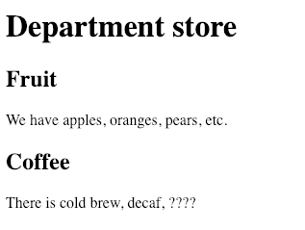
What tags can we spot here?
<!doctype html>
<html>
<head></head>
<body>
<h1>Department store</h1>
<div>
<h2>Fruit</h2>
<p>We have apples, oranges, pears, etc.</p>
</div>
<div>
<h2>Coffee</h2>
<p>There is cold brew, decaf, ????</p>
</div>
</body>
</html>

Slide 51
What is a div tag?
An empty, meaningless box!
"Divides" up page content for better structure — grouping things
<!doctype html>
<html>
<head></head>
<body>
<h1>Department store</h1>
<div>
<h2>Fruit</h2>
<p>We have apples, oranges, pears, etc.</p>
</div>
<div>
<h2>Coffee</h2>
<p>There is cold brew, decaf, ????</p>
</div>
</body>
</html>
Notes:
The <div> tag is the general-purpose tag we’ve been looking for! A <div> is so called because it “divides” the page into smaller parts. A <div> isn’t special in any way -- it doesn’t add any style or text or images or buttons. Instead, it just allows us to group related other tags together inside <div> tags, for better organization.
By itself, it’s just an empty box. But as we get into CSS, we’ll leanr how powerful general-purpose tags can be.

Slide 52
Semantic HTML example: div vs. section
<!doctype html>
<html>
<head></head>
<body>
<h1>Department store</h1>
<div>
<h2>Fruit</h2>
<p>We have apples, oranges, pears, etc.</p>
</div>
<div>
<h2>Coffee</h2>
<p>There is cold brew, decaf, ????</p>
</div>
</body>
</html>
<!doctype html>
<html>
<head></head>
<body>
<h1>Department store</h1>
<section>
<h2>Fruit</h2>
<p>We have apples, oranges, pears, etc.</p>
</section>
<section>
<h2>Coffee</h2>
<p>There is cold brew, decaf, ????</p>
</section>
</body>
</html>
Notes:
SEMANTIC HTML IS IMPORTANT!
What is “Semantic HTML”?
Semantic HTML is a phrase that means HTML code -- especially the tags we use -- have to have some meaning behind them. Semantic HTML is an idea web developers introduced after they realized that too many developers were using general purpose tags like <div> to do anything and everything, when more specific, meaningful tags will do.
HTML 5 has tags for <header>, <footer>, <article>, <menu>, and so much more -- these tags are specific to their role on the webpage, and add additional meaning -- semantics -- to the tags, rather than simply divide up the page like <div>.
Semantic HTML is super important because:
It adds meaning and structure to the page that isn’t possible with a bunch of <div> tags, and
It allows non-visual browsers like screen readers and braille-based browsers to discern which parts of the page are most important.
Anytime you want to use <div> to section off large parts of the page, you should first think about if there’s a more specific, meaningful tag like <header> or <nav> that will fit better.

Slide 53
Very exciting.
Notes:
So far, we’ve covered a large part of HTML, the skeleton of webpages! That’s very exciting!
But wait, there’s more!

Slide 54
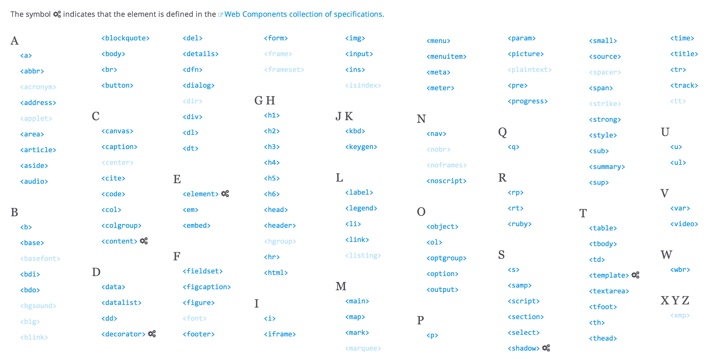
Notes:
There are many HTML tags, over 100, but you will only use a handful of them throughout your web design career. You will learn more about the tags in your activity and homework but you will inevitably forget what a tag does or what the proper tag is for something. On of the keys to being a good web designer and a good programmer is that you have good Googling skills. It’s easy to look up which HTML tags are available, and we encourage you to do so if ever you’re in doubt or curious.

Slide 56
A Shallow Dive into Image Embedding

Slide 57
Image tag
<!doctype html>
<html>
<head></head>
<body>
<!-- this itself is a comment -->
<!-- your webpage content goes inside the body -->
<p>Welcome to WDD!</p>
<img src=”wdd.png” />
</body>
</html>
Notes:
The exceptions to the “tags come in pairs” rule are called self-closing tags. These exist because some kinds of content can’t really contain other content. For example, it makes sense for a button to have an image inside it, but it doesn’t make sense for an image to have an input field inside, or for an input field to have a paragraph inside. These independent, self-contained elements are represented by self-closing tags, which have one tag that both opens and closes itself.
Self closing tags have just one tag, but it ends with a “/>” rather than a simple “>”.
One great example is the image tag, <img/>.

Slide 58
What is an image tag?
Embeds an image on the web page
You can put a link to the image in the src property (make sure to include the file extension — .jpg, .png, .gif
The link is CaSe-SeNsItIvE Double check if it's WDD.JPG or wdd.jpg
<img src=”wdd.png” />

Slide 59
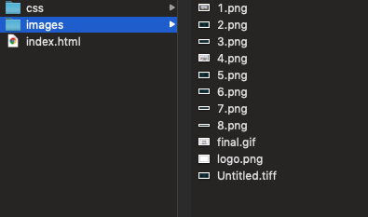
For your homework — One way to link images
Navigate -> to the folder that contains your index.html file
Create or find an images folder as shown.
Insert images and name them whatever you like, but make sure to include the file extension (.jpg, .png, etc)
Insert the following in your index.html file
<img src= “./images/[YOUR FILE NAME HERE]” />
Example: <img src= “./images/wdd.png” />
We’ll cover what this means in a later lecture!
example of a file directory

Slide 60
For your homework
Homework 1 is released tonight and is due next Monday 7pm.
It covers basic syntax of HTML and will guide you through making your first website.
Find it on WDD Portal!
Feel free to ask questions on Piazza!
example of a file directory

Slide 61
What is HTML?
What does it look like?
How do we use it?

Slide 62
HTML Practice
tinyurl.com/wed-html-demo
Notes:
If you’re reading these notes after the lecture, we highly encourage you to click into the demo link and follow the directions written in the HTML comments to see firsthand how HTML works.
Note that after you make any changes to the HTML code, you’ll need to hit “Run” at the top of the page to make the changes visible.

Slide 63
That's all folks!

Slide 64
Helpful links
HTML Tag references:
MDN Web Docs: HTML elements reference
W3Schools: HTML reference
🔖 Bookmark these for later! ^^

Slide 65
Deep think
How does this parent-child hierarchy constrain our design?
Self closing tags are much less common than paired tags, why?
Theoretically, we could just use the div tag (except maybe head and body and html). Why do we then have other tags?
(Deeper) We can observe the parent-child relationship in HTML is similar to that in a tree data structure. What’s the root of this tree? What are the advantages (and disadvantages) of such a data structure that led people to design HTML this way?
(Deeper) Based on what we've learned, design your "HTML" (as a language) so that we can better facilitate the design process. Which data structure would you base your design on?

